Slide 1
ICT(information Communication Technology)
IT(information Technology)

Slide 2
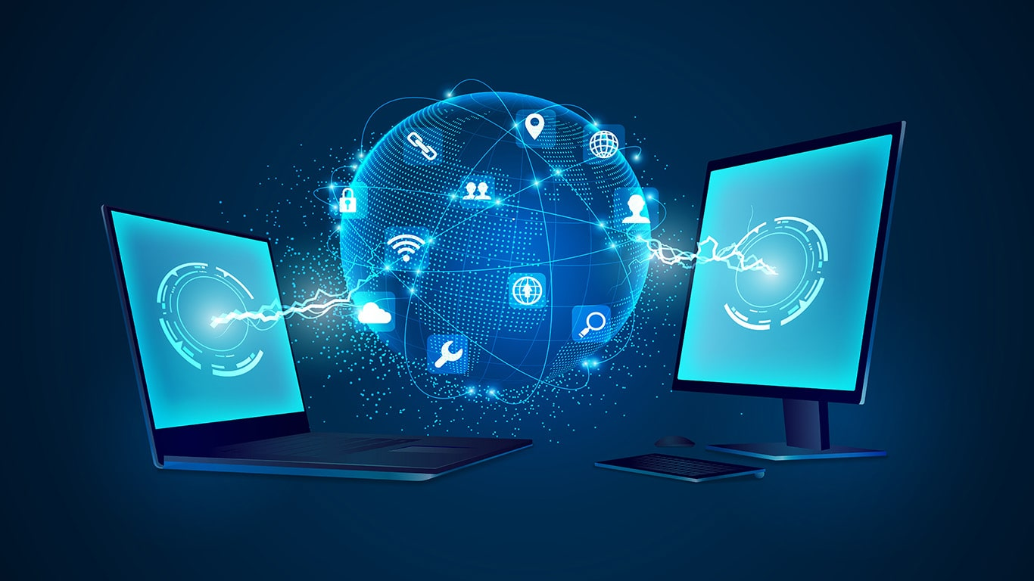
IT (Information technology)
IT focuses mainly on using computers and software to manage and process information.
Ex : using a computer to store documents or run a database.

Slide 3
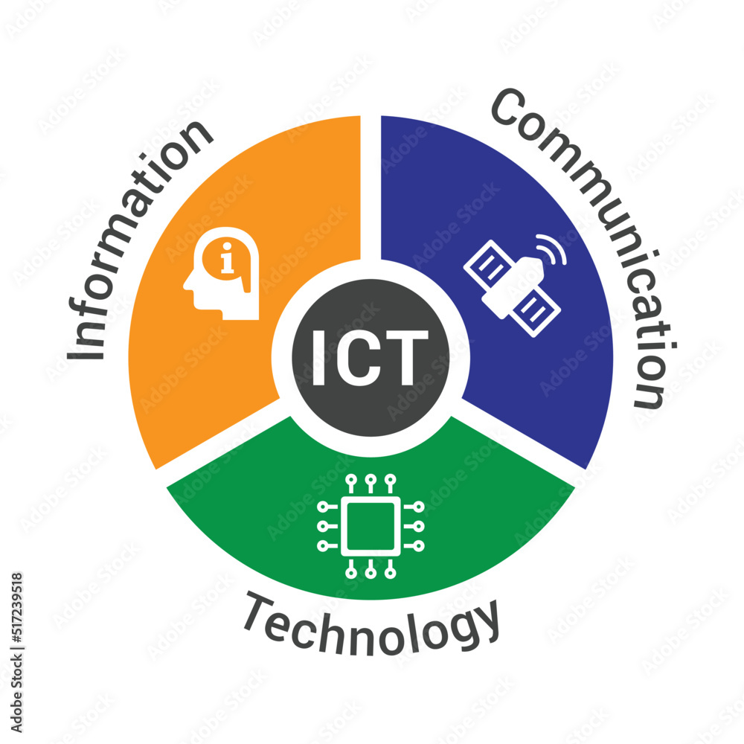
ICT (Information Communication technology)
Information and communications technology (ICT) is the use of computing and telecommunication technologies, systems, and tools to facilitate the way information is created, collected, processed, transmitted, and stored. It includes computing technologies like servers, laptop computers, and software applications, as well as the wired and wireless communication.

Slide 4

ICT ?
IT ?

Slide 5

ICT(information and communication technology) is the broader term compared to IT(information technology).
ICT Includes everything that IT does, but also adds the communication aspect.
So, ICT is about using technology to process, store and share information through communication tools like the internet, phones, or networks

Slide 6
Advantages of IT
Increased Efficiency and Productivity
Automation of routine tasks saves time and reduces errors.
Tools like ERP systems and project management software streamline operations.
Global Connectivity
Enables communication and collaboration across the globe through emails,
video conferencing, and social media.
Facilitates remote work and global markets.

Slide 7
Advantages of IT
Access to Information
Provides quick access to vast amounts of information via the internet and databases.
Enhances decision- making with data analytics and business intelligence tools.
Innovation and Creativity
Supports the development of new products, services, and business models.
Enables creative tools for design, art, and multimedia.
Cost Savings
Reduces costs through automation, outsourcing, and cloud computing.
Minimizes physical storage with digital data management.

Slide 8
Disadvantages of IT
Cybersecurity Risks
Susceptible to hacking, phishing, and malware attacks.
Potential for data breaches leading to privacy violations.
Job Displacement
Automation can replace jobs in manual or repetitive roles.
Creates a need for upskilling to stay relevant in the workforce.
Dependency and Overreliance
Organizations and individuals may become overly dependent on IT systems.
Failures or downtime can disrupt operations and services.

Slide 9
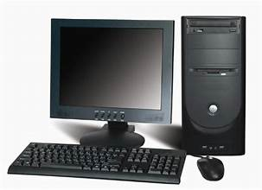
Introduction to computer systems
It is an electronic device that can receive, store , process and output data according to programmed instructions

Slide 10
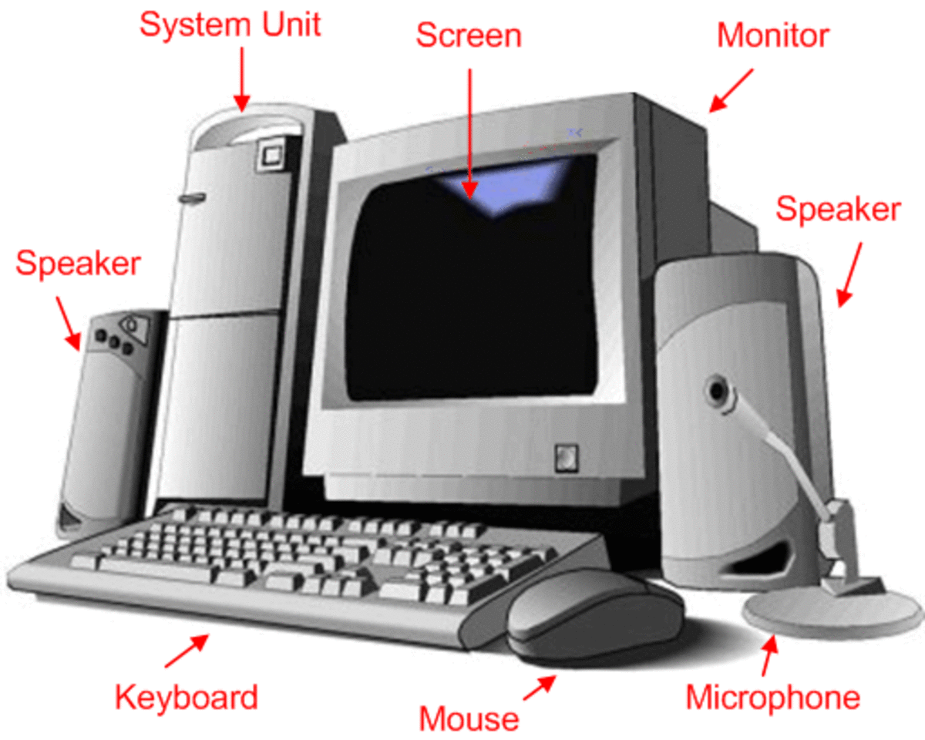
Main parts of computer:
Monitor: it is like a tv screen , it displays information generated by computer.
Mouse: it is a pointing device , it moves with our hand to point a select things on the screen.
Cpu: it stands for central processing unit , it is the brain of computer . It controls all activities and calculations of computers.
Keyborad: It looks like a type writer , it is used to type letters , numbers , and symbols into the computer.

Slide 11
Classification of Computers , or types of computers
Classification means grouping computers based on their characteristics, features or purposes.
Why classify computers?
To understand their.
Processing power
Size and portability
Functionality
Cost
Performance
speed

Slide 12
Main categories of computer :
Personal computer :
It is designed to be used by one person at a time.
It consists of a processor, memory and one or more input , output storage devices.
Personal computers are available in different shapes and size .
1: Desktop computer.
>tower model
> All in one
2:Laptop (consume less power as compared to desktop computer .
It is also all in one .

Slide 13
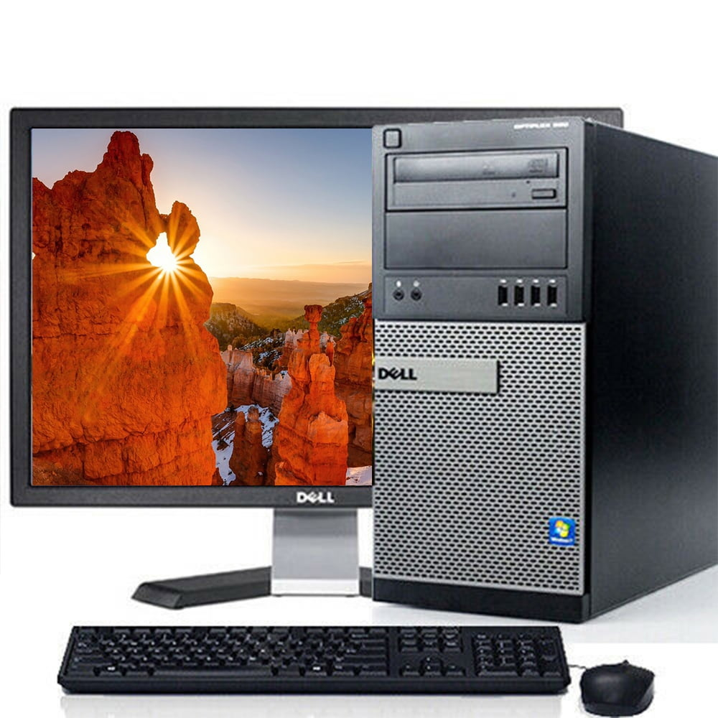
Tower Desktops:
It has a separate central processing unit (cpu) tower and peripherals,(monitor , keyboard,mouse)

Slide 14
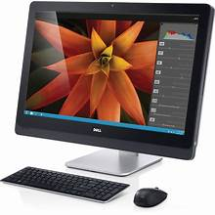
All in one desktop:
AIO desktops integrate the cpu, monitor,
and peripherals into a single unit.

Slide 15
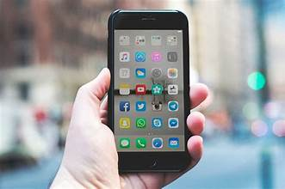
Mobile devices:
A mobile devices is a computing device designed to hold in the hand .
The program and data are permenanately stored on the special memory or on a card.

Slide 16
Mini Computer:
Released in 1960’s :
Minicomputers got their name because of their small size compare to other computer of the day.
Mini computers are also called midrange computers.
Because they sit between mainframe computers (large , expensive , powerful systems used by orginizations).
And micro computers (smaller, personal , computers like desktops or laptops.
Example :
DEC PDP-8- One of the first mini computers , used in business and universities in 1960’s

Slide 17
Main Frame computers:
These are large computers in terms of power , speed and price.
It consist of multiple processor , it is more powerful than mini computers.
Used in large organizations such as insurance company and banks. Where many people frequently need use the same data.
In a traditional mainframe environment, each user access the mainframes resources through a device called a terminal.

Slide 18
Terminal:
A terminal is a device that allows users to interact with the mainframe(Like bridge)
Used for Entering data.
Retrieving data.
Input/output device

Slide 19
There are two types of terminals.
1.Dumb Terminal.
Does not store or process data.
As it is data will send to the remote server.
And that server will compute that data.
And then it will response on the dumb terminal screen.
It simply use for data entering.
Ex : Air line reservation system.

Slide 20
Smart terminal:
Limited memory:
It is used for data entry.
Debit cart machine.
And it is connected with main system.

Slide 21
Super Computers:
These are the most powerful computers made, and physically they are some of the largest.
These systems can process huge amounts of data , and fastest super computers can perform the more than one trillion calculations per seconds

Slide 22
Embedded Computers:
AN embedded computer (embedded programs) is a special purpose computer that functions as a component in a larger product.
Ex : used in car lock and unlock
used in air conditions

Slide 23
Server Computers:
Server computer is a role that means we can assign to any computer.
A server computer that provides services to the computers and other devices connected to a network.
Client Computers: are those who request to the server computers for resources.
It is less powerful than server computers

Slide 24
Services of server computer.
1: Control access to the hardware , software and data.
2.Centralized storage for software , data and information.
3.Data Processing

Slide 25
Computer Users:
Computer Professionals:
Computers Users : Definition: A computer user refers to anyone who operates a computer to perform various tasks. They typically interact with software applications, websites, or systems to achieve their personal, educational, or professional goals.

Slide 26
Computer Professionals:
Computer Professionals
Definition: A computer professional is someone who has specialized knowledge, skills, and training in the field of computing. They design, develop, manage, and maintain computer systems, software, and networks.
Key Characteristics:
Expertise: Requires in-depth technical knowledge in areas like programming, network security, database management, or hardware design.

Slide 27
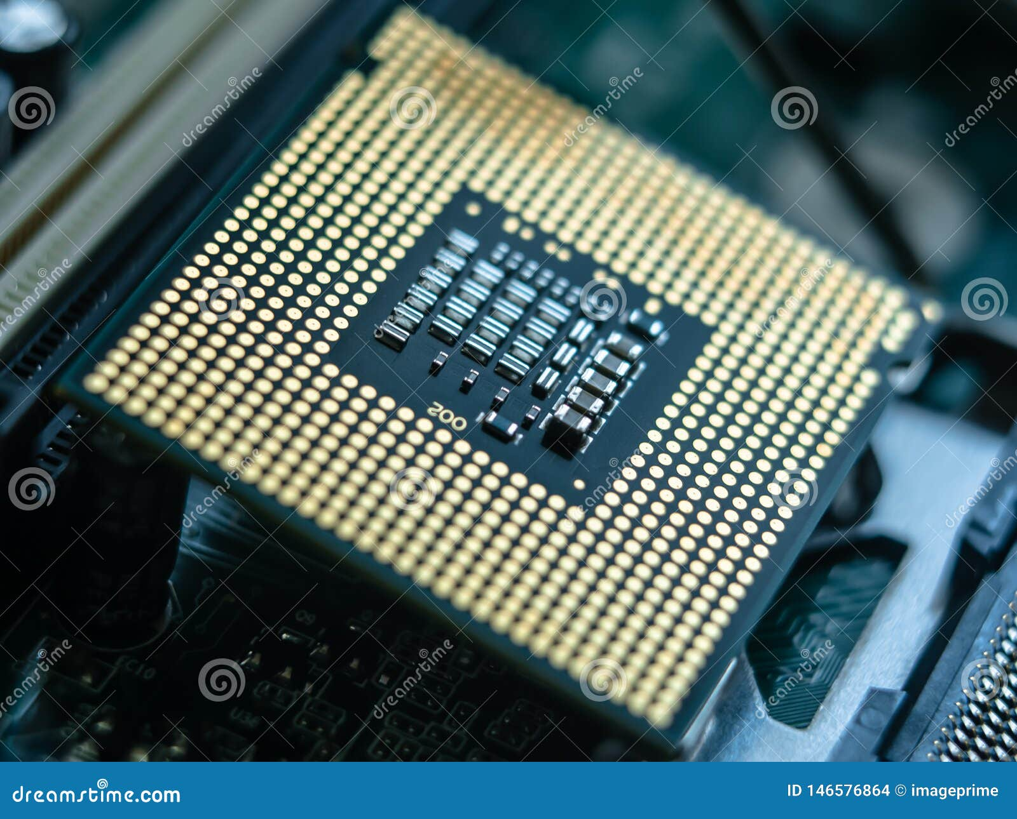
Processor:
IT is a chip which is called CPU.
It is embedded in motherboard processor slot.

Slide 28
Core I : (Intel)
IT shows the speed of the processor .
Dual core processor means 2 core.
Quad core processor means 4 core.
Hexa core processor means core.
Processor = Gega Hertz And Mega Hertz

